Slide 1
The structured programming theorem

Slide 2
Outline
In this lesson, we will:
Review the statements we have seen to this point
Look at some very ugly flow charts apparently implementable only with a goto statement
Review theorems and present the structured programming theorem
Look at some simple consequences based on flow charts
See how to use the structured programming theorem when designing algorithms

Slide 3
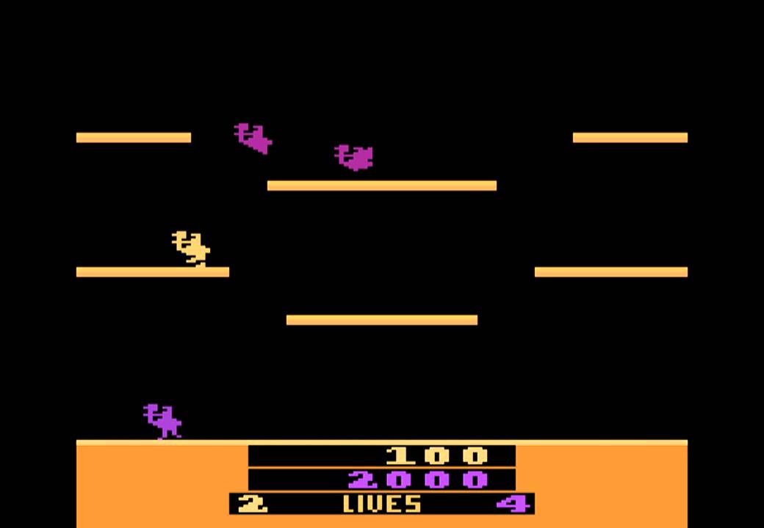

Background
You’ve seen used and observed numerous applications, some of which may amaze you
You ask yourself, how can you do something like this?
The answer: Libraries and the structured programming theorem
Joust, Williams Electronics
Fortnite, Epic Games

Slide 4
Background
The C++ language is very complex, and for many and good reasons
There are many features designed to support the development of software
The C++ standard costs 198 Swiss Francs (~266 cad) and is over 1600 pages
Most of you will never master the language—and that’s okay
No instructor has, either…

Slide 5
Background
In your mathematics courses, you have seen a few theorems:
A theorem is a statement must be true if a given set of premises are true
Examples:
Euclid’s theorem
There are infinitely many prime numbers
The Pythagorean theorem
If a, b, and c are sides of a right-angled triangle, and c is the side opposite the right angle, then a² + b² = c²
The remainder theorem
If a polynomial p(x) is divided by (x – r) , the remainder is p(r)
The factor theorem
A polynomial p(x) has a factor (x – r) if and only if p(r) = 0

Slide 6
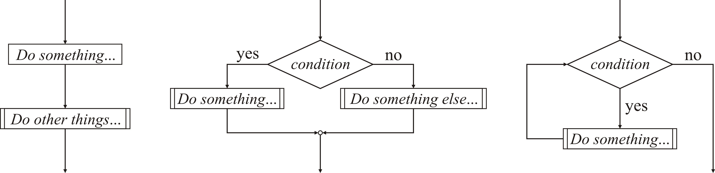
The flow charts so far
To this point, we have described:
Blocks of statements {statement; …}
Conditional statements if ( condition ) {…} else {…}
while loops while ( condition ) {…}

Slide 7
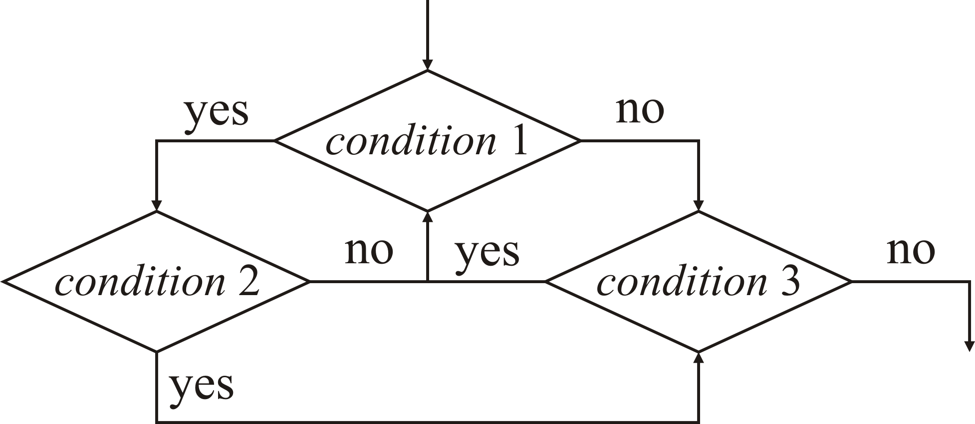
The flow charts so far
It is possible, when designing algorithms, to come up with flow charts that cannot be built up from these three statements
For example, consider:

Slide 8
The flow charts so far
It is always possible to use goto statements to implement any flow chart
first: if ( condition-1 ) {
goto second;
} else {
goto third;
}
second: if ( condition-2 ) {
goto third;
} else {
goto first;
}
third: if ( condition-3 ) {
goto first;
}
Identifiers can be used as labels

Slide 9
The flow charts so far
The use of the goto statement leads to serious maintenance issues
Code becomes more difficult to understand, analyze, debug, extend or otherwise maintain
Your costs will go up, your profits will go down

Slide 10
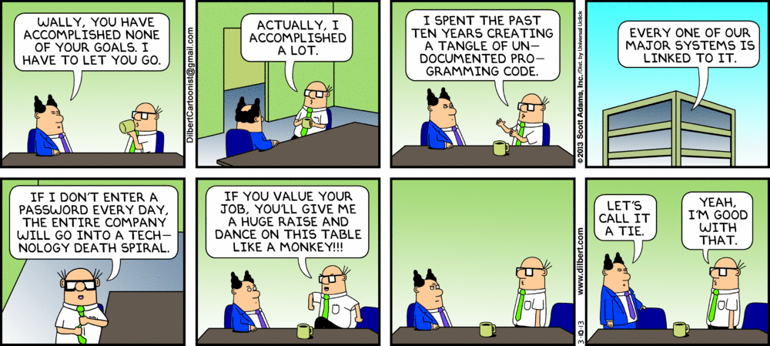
The flow charts so far
Worse yet: you will never be able to let those programmers who authored that atrocious code go:
Worst of all: any solution to an assignment or examination question that contains a goto statement will receive a grade of 0

Slide 11
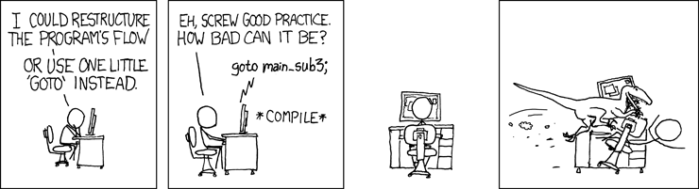
It’s rocket science…
Even the Jet Propulsion Laboratory (jpl) has included this rule:
Rule 11 (simple control flow)
The goto statement shall not be used.

Slide 12
The structured programming theorem
Fortunately, the following theorem says we don’t need any more:
Any program that can be written can be written using flow charts that combine only the three statements we have seen to this point

Slide 13
The structured programming theorem
Consequences:
You understand most of the tools already
When you learn a new programming language, first understand how to write:
conditional statements, and
while loops
When you tackle a problem that require the repetition of a given set of operations, think in terms of a while loop:
“We must perform this set of instructions while this condition is true”

Slide 14
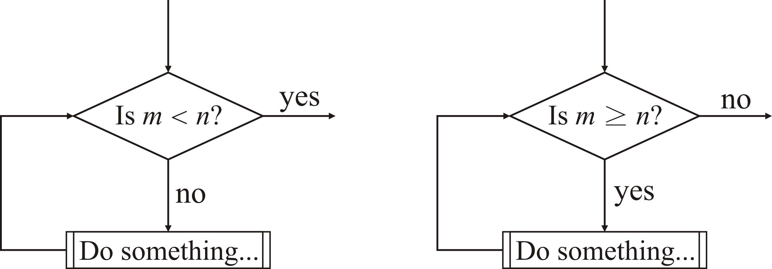
Equivalent flow charts
These flow charts are equivalent
The left cannot be implemented using a while loop, the right can

Slide 15
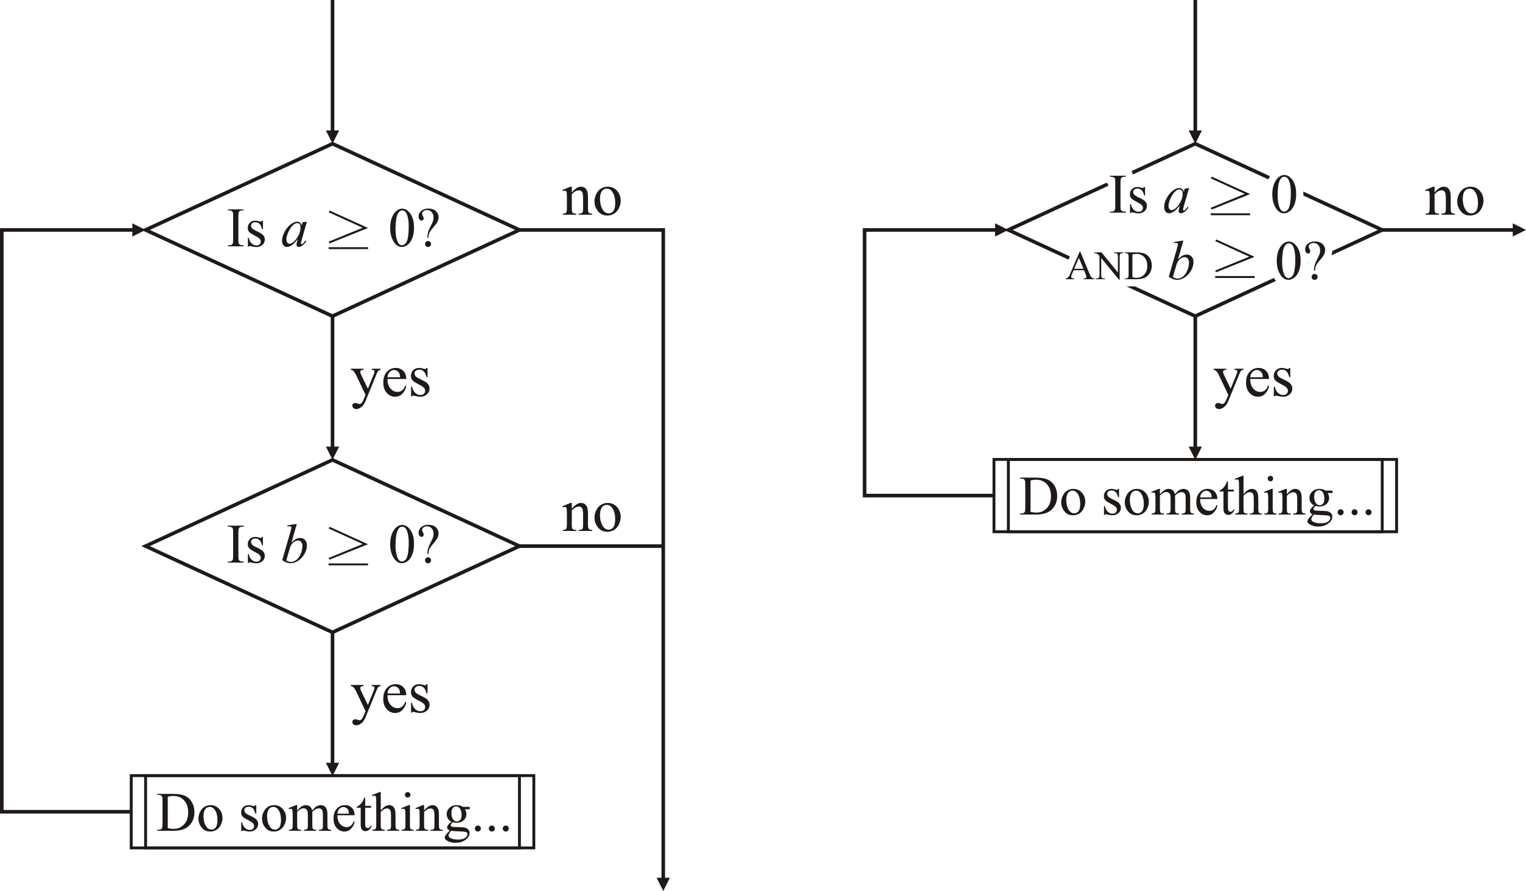
Equivalent flow charts
These flow charts are also equivalent
The left cannot be implemented using a while loop, but using the logical and operator, the right can

Slide 16
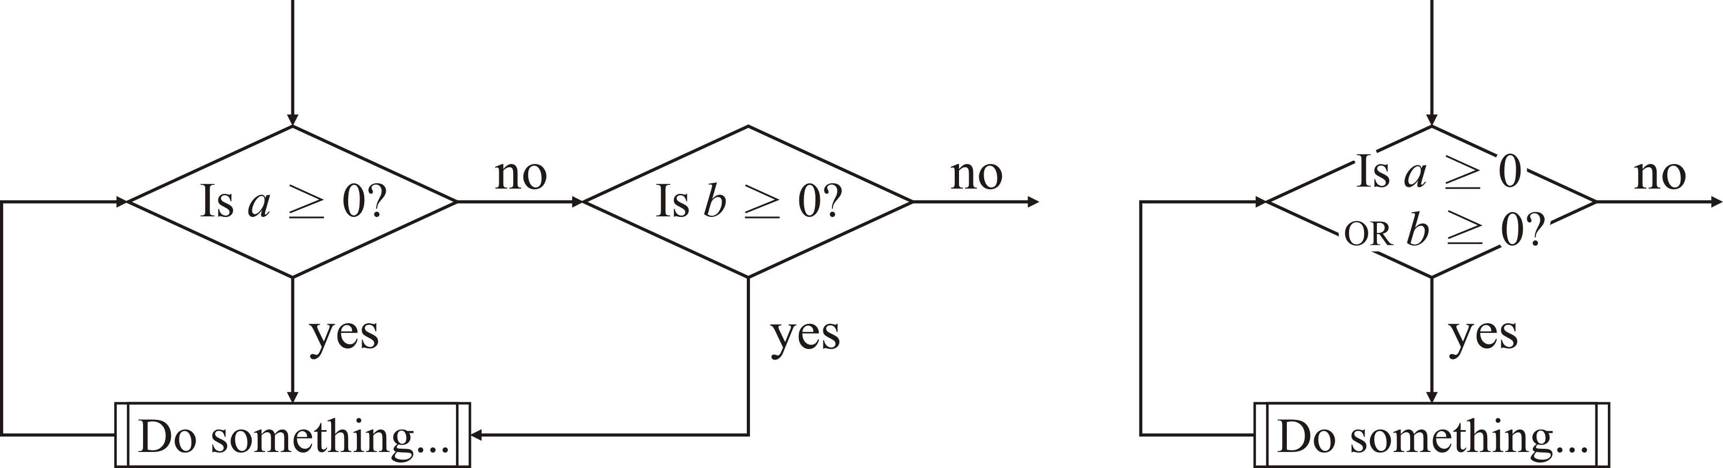
Equivalent flow charts
These flow charts are also equivalent
The left cannot be implemented using a while loop, but using the logical or operator, the right can

Slide 17
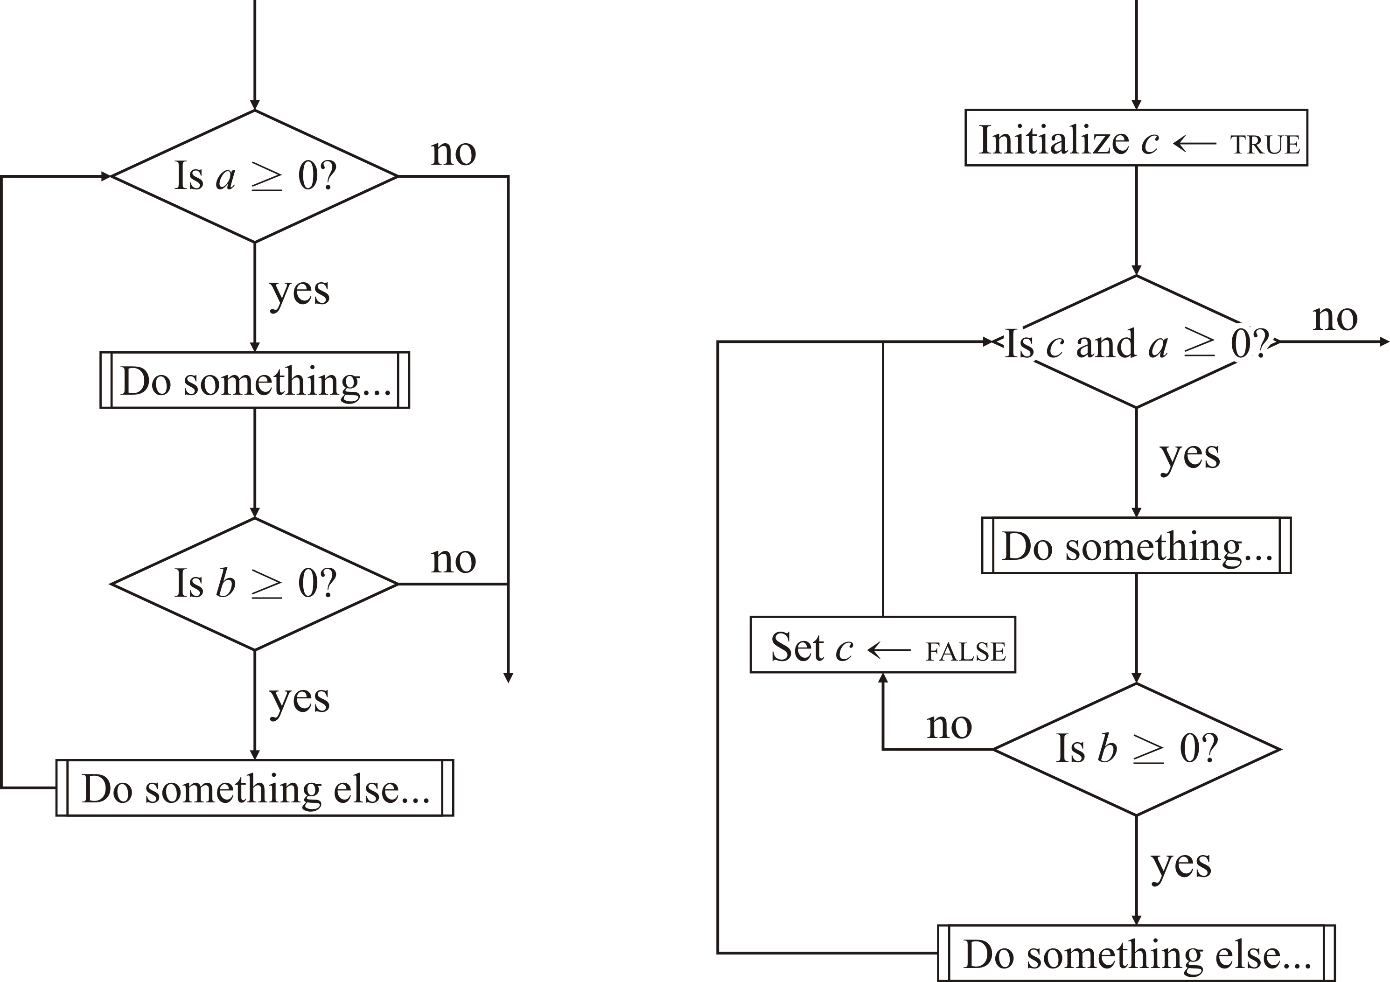
Equivalent flow charts
These flow charts are also equivalent
The left cannot be implemented using a while loop, but using a temporary Boolean variable, the right can
The variable c is called a Boolean flag

Slide 18
Equivalent implementations
Compare these implementations of an algorithm for sorting an array:
void unstructured( double array[], size_t capacity ) {
start: if ( capacity == 0 ) {
return;
}
size_t n = 0;
size_t k = 1;
double max = array[0];
next: if ( k == capacity ) {
array[k - 1] = max;
capacity = n;
goto start;
}
if ( max < array[k] ) {
array[k - 1] = max;
max = array[k];
} else {
array[k - 1] = array[k];
n = k;
}
++k;
goto next;
}
void structured( double array[], size_t capacity ) {
while ( capacity > 0 ) {
size_t n = 0;
size_t k = 1;
double max = array[0];
while ( k < capacity ) {
if ( max < array[k] ) {
array[k - 1] = max;
max = array[k];
} else {
array[k - 1] = array[k];
n = k;
}
++k;
}
array[k - 1] = max;
capacity = n;
}
}

Slide 19
Moral of the story…
You will not be required to seriously investigate the structured programming theorem or to prove two flow charts are equivalent
Use this as a guide to designing algorithms:
Always think in terms of looping while some condition is true
Understand when you need to terminate the loop
Always ask Boolean-valued questions, either for while loops or conditional statements

Slide 20
The flow charts so far
To go back to our first example:
bool flag_1{ true };
while ( flag_1 ) {
bool flag_2{ false };
if ( condition-1 ) {
// Block A
if ( condition-2 ) {
// Block E
flag_2 = true;
} else {
// Block C
}
} else {
// Blcok B
flag_2 = true;
}
if ( flag_2 ) {
if ( condition-3 ) {
// Block D
} else {
flag_1 = false;
}
}
}
A
B
C
D
E
first: if ( condition-1 ) {
// Block A
goto second;
} else {
// Block B
goto third;
}
second: if ( condition-2 ) {
// Block E
goto third;
} else {
// Block C
goto first;
}
third: if ( condition-3 ) {
// Block D
goto first;
}

Slide 21
Summary
Following this lesson, you now:
Understand that you should never use a goto statement
Understand the consequences of the structured programming theorem
Know that conditional and while loops are all you need
Understand that flow charts can be rewritten to allow them to be implemented using these statements
We saw logical operators and Boolean flags

Slide 22
References
[1] Wikipedia
https://en.wikipedia.org/wiki/Structured_program_theorem

Slide 23



Colophon
These slides were prepared using the Georgia typeface. Mathematical equations use Times New Roman, and source code is presented using Consolas.
The photographs of lilacs in bloom appearing on the title slide and accenting the top of each other slide were taken at the Royal Botanical Gardens on May 27, 2018 by Douglas Wilhelm Harder. Please see
https://www.rbg.ca/
for more information.

Slide 24
Disclaimer
These slides are provided for the ece 150 Fundamentals of Programming course taught at the University of Waterloo. The material in it reflects the authors’ best judgment in light of the information available to them at the time of preparation. Any reliance on these course slides by any party for any other purpose are the responsibility of such parties. The authors accept no responsibility for damages, if any, suffered by any party as a result of decisions made or actions based on these course slides for any other purpose than that for which it was intended.

